Slide 1
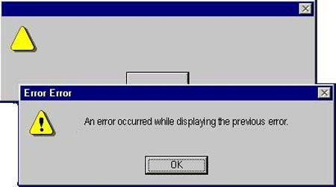
Welcome to Messages and Email Ease

Slide 2
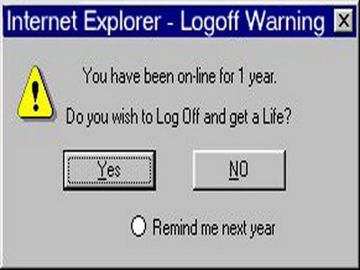
Do you ever feel like you never leave the computer?

Slide 3
When should you message?
You have a question.
You need an assignment reset.
You aren’t sure you are doing your assignment correctly?
You just want to say hi!

Slide 4
When should you not message?
You just submitted an assignment and it hasn’t been graded yet.
You are submitting an assignment.
You need to talk to both your mentor and me!

Slide 5
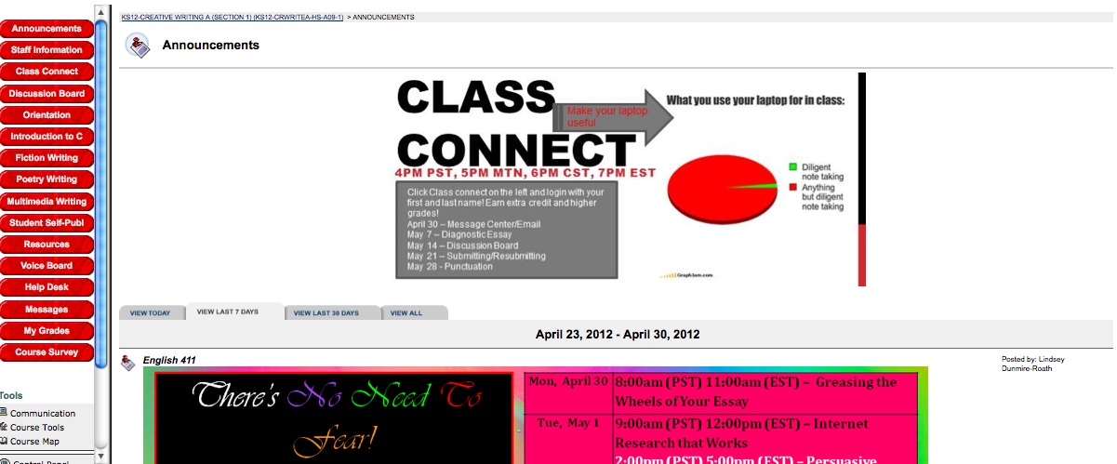
Sending a message : 1
Click on Messages

Slide 6
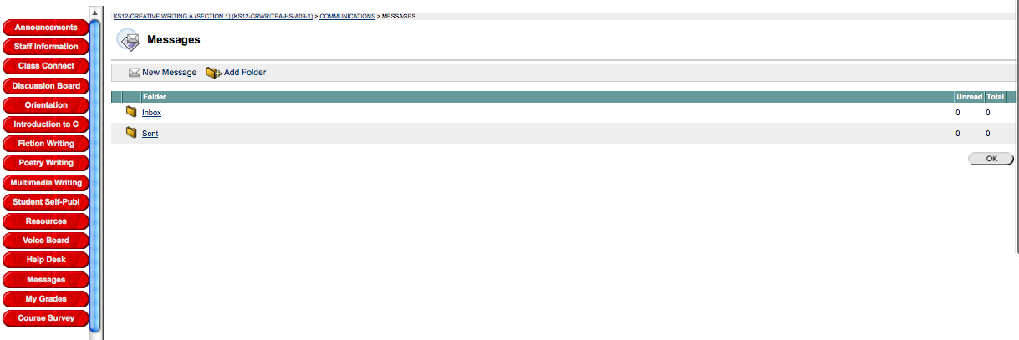
Step 2:
Click on New Message

Slide 7
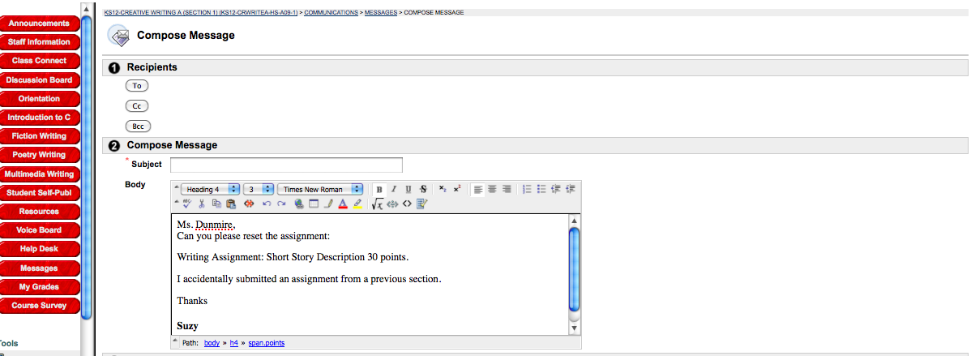
Be Specific
Specific Assignment Name
Background reasoning

Slide 8
Tips and Tricks
Address your email
Be polite
Be specific about what class and section you are in if emailing.
Be Specific with the assignment you have questions about. Say the assignment name and what you don’t understand. Don’t just say you don’t get it!

