Slide 1
Plagiarism
Dunmire

Slide 2
Plagiarism is….
Taking something without permission and claiming it as your own

Slide 3
What this means…
A student finds a website that has an AWESOME article/paper on it, they copy it and hand it in to the teacher. The teacher thinks the student wrote it.
This article has now been plagiarized.

Slide 4
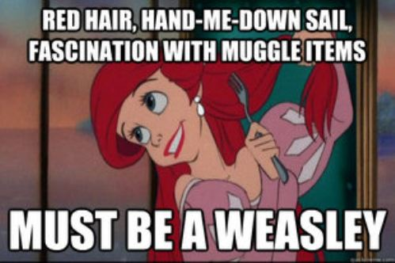
An Example

Slide 5
Many sites provide students with an actual paper
Sites to look out for are:
Squidoo
Anything that includes “papers” in the title
Term papers
Essays
BLOGS
Anything you take from these is plagiarism

Slide 6
Problems with these sites
You have no idea who wrote the paper
You are probably stealing from someone who has no idea what they are talking about
It’s easy to determine that someone didn’t write a paper
Requirements
Effectiveness
Point of View

Slide 7
Getting USABLE info
You can use a variety of different information you find on the internet
YOU MUST GIVE CREDIT to who did it!
Here are some examples:

Slide 8
Example 1
Feffer, John. "A Multipolar Moment? | FPIF." Foreign Policy In Focus | International Affairs, Peace, Justice, and Environment. 17 Feb. 2009. Web. 16 Nov. 2011. <http://www.fpif.org/articles/a_multipolar_moment>.

Slide 9
Example 2
Layne, Christopher, and Bradley A. Thayer. American Empire : a Debate. New York: Routledge, 2007. 70-71. Print.
Source text (if electronic): After 9/11, many foreign policy analysts and pundits asked the question, “Why do they hate us?” This question missed the key point, however. No doubt, there are Islamic fundamentalists who do “hate” the United States for cultural, religious, and ideological reasons. And, for sure, notwithstanding American neoconservatives’ obvious relish for making it so, to some extent the War on Terrorism inescapably has overtones of a “clash of civilizations.” Still, this isn’t—and should not be allowed to become—a replay of the Crusades. As Scheuer says, “one of the greatest dangers for Americans in deciding how to confront the Islamist threat lies in continuing to believe—at the urging of senior U.S. leaders—that Muslims hate and attack us for what we are and think, rather than for what we do.” The United States may be greatly reviled in some quarters of the Islamic world, but were the United States not so intimately involved in the affairs of the Middle East, it’s hardly likely that this detestation would have manifested itself as violently as it did on 9/11. Experts on terrorism understand the political motives that drive the actions of groups like al Qaeda. In his important recent study of suicide terrorists, Robert A. Pape found that what “nearly all suicide terrorist attacks have in common is a specific secular and strategic goal: to compel modern democracies to withdraw military forces from territory that the terrorists consider to be their homeland.”56 Pape found that “even at Qaeda fits this pattern: although Saudi Arabia is not under American military occupation per se, a principal objective of Osama bin Laden is the expulsion of American troops from the Persian Gulf and the reduction of Washington’s power in the region.” This finding is seconded by Scheuer, who describes bin Laden’s objectives as: “the end of U.S. aid to Israel and the ultimate elimination of that state; the removal of U.S. and Western forces from the Arabian Peninsula; the removal of U.S. and Western military forces from Iraq, Afghanistan, and other Muslim lands; the end of U.S. support for oppression of Muslims by Russia, China, and India; the end of U.S. protection for repressive, apostate Muslim regimes in Saudi Arabia, Kuwait, Egypt, Jordan, et cetera; and the conservation of the Muslim world’s energy resources and their sale at higher prices.” Simply put, it is American primacy, and the policies that flow from it, that have made the United States a lightning rod for Islamic anger.

Slide 10
Helpful Cites
Easybib.com
Citationmachine.net
Either of these make it super easy to cite sources correctly and quickly!

