Slide 1
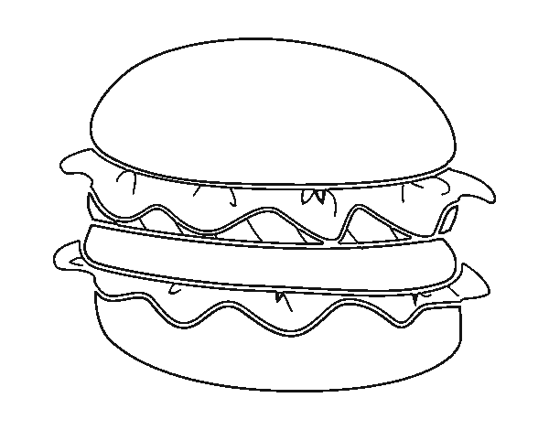
Step 1- Make Thesis
Step 3 – Make Conclusion
Thus
Further
Therefore
However
Finally
Furthermore
Also
Then
That being said
T – Topic-
Comes from Essay Prompt
O- Opinion
Comes from your Brain
P - Point 1
P - Point 2
P – Point 3
= THESIS
Transition
Review Pt 1
Review Pt 2
Review Pt 3
Refer Back to Attention Getter
Transition Words
Step 2- Make Introduction
Step 4- Body Paragraphs
1. Attention Getter
a. Statistic
(9/10 people chew gum)
b. Story
(I got gum in my hair once and…. )
c. Quote
(In F451, Montag says “…(Bradbury 1)”
2. Explanation of attention getter
3. Connection to topic
4. Connection to topic
5. Thesis Statement
Para 1
Para 2
Para 3
Transition and Topic Sentence
Quote
Citation (Author #)
Connection to Prompt
Explain the quote
Transition sentence
Dunmire 2013

Slide 2
To – relationship to something
Too - Also
Two - 2
Their – people
They’re – They are (people)
There – over yonder
Checklist
Is your “I” capitalized?
Do you have punctuation? Do you have a capital letter to start each sentence?
Do you use pronouns? (I, we, me, them, us or you)
Use your helping verbs:
Be, am, is, are, was, were, been, have, has, had, do, does, did, can, could, shall, should, may, might, must
What had happened was….WRONG
Word that can be used to compare
two things:
Words that can be used to contrast two things:
Words that can be used to emphasize a point:
likewise | also | while | in the same way
like | as | similarly
Made up word vs. Actual Word
Hisself Himself
Themselfs/theirselves Themselves
Not noone Noone or not anyone
but | still | although | on the other hand
however | yet | otherwise | even though
again | truly | especially | for this reason
to repeat | in fact | to emphasize

