Slide 1
November 10, 2014

Slide 2
November 10
AGENDA
SSR
Journal
Thesis Statements
Outline Creation
Rearrange PPT ideas into Outline
Exit Ticket

Slide 3
Journal
Dana decided too skip volleyball practice and has to run three sets of bleechers

Slide 4
Thesis Statements
A final sentence that tells the reader exactly what you will say in your paper.
It’s your roadmap for the paper.
Is one sentence, and only one sentence.
Should be gramatically correct.
Should preview all the things you are going to talk about, and should go in order.

Slide 5
Thesis Statements
1. Treat this like a Mad Lib or a Fill in the Blank.
2. Go to your essential questions in your proposal. (you will also write your thesis here)
3. Group the Eqs by common ideas, 2 per idea, make them different colors.
4. Now group those ideas into 1 word ideas.
5. Fill in these blanks:
_Topic__is__Adjective_because __pt1__, _pt2___, and __pt 3___.

Slide 6
Making your Outline
1. Open a new document in Assignments.
label it Last Name Outline.
2. Take your 3 points from your thesis statement and make them into 3 individual sentences that state fact, not opinion.
3. Put the 3 sentences from #2 into the outline under II, III, IV.

Slide 7
Pt 1
Make a sentence.
THESIS- has 3 pts
Pt 2
Move
Make a sentence.
to II
III IV
in
Pt 3
Make a sentence.
Thesis: Plastic surgery is treacherous because of the cost, miscalculations and health risks.
II. Plastic surgery is risky due to cost. III. Plastic surgery has many potential side effects.
IV. Health risks are often associated with plastic surgery.
Follow the colors.

Slide 8
November 11
Agenda
SSR
Journal

Slide 9
Journal
Write a story including all of these words:
Grandma
Casino
Ipad
apron

Slide 10
November 11
Notes

Slide 11
What is a quote?
Anything that isn’t yours.
Doesn’t mean it is in quotes to begin with.
If it is in quotes to begin with, it is dialogue, or taken from someone else already.
Something you can’t put in your own words

Slide 12
Paraphrase vs. Direct Quote
Paraphrase
Put in your own words
Make something make sense to you
Direct Quote
Extensive
Well written
Too hard to make your own
Technical

Slide 13
Two ways to introduce evidence
Author name explains “direct quote” (pg#).
Author name explains paraphrase (pg#).
OR
“Quotation” (Author Pg#).
Paraphrase (Author Pg #).

Slide 14
Follow Me.
Your II, III, and IV are the topic sentences for your paragraphs.
If you haven’t connected it yet I and V are your intro and conclusion ☺
Begin writing your paragraphs for your rough draft. Where you put a source, just put the presentation slide citation (A1, D4 etc, so when you type, it is available).
Copy the quote or paraphrase into your rough draft.
No you can’t type it yet.

Slide 15
November 12
AGENDA

Slide 16
Journal
Inform me about either a pet or a pet peeve

Slide 17
November 13

Slide 18
Journal
Tell this story

Slide 19
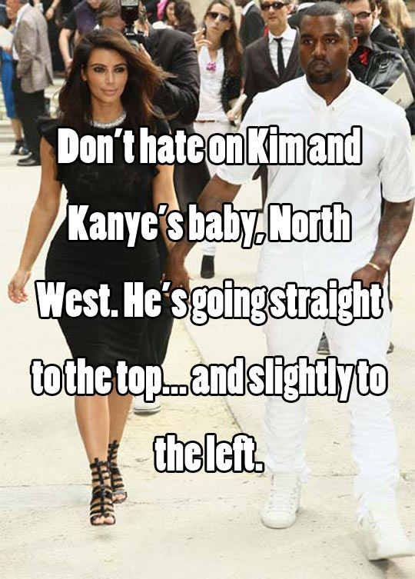
November 13

Slide 20
Journal
Reflect on your week
How are you feeling/thinking/being?

