Slide 1
It’s Monday
November 3, 2014

Slide 2
Agenda
SSR
Journal
Notes/Video
Set Up Gdoc research
Project Proposal Work Time

Slide 3
Journal
Imagine you are 25, where do you hope to be in life?
Journals are due at the end of the week. You should have 3 weeks worth of writing.

Slide 4
Notes

Slide 5
Research Questions
Video
Should be open ended.
Open ended = multiple lengthy answer options
Close ended = one word response
Should be objective
Your opinion doesn’t matter here.
Ex- Why were they testing on humans instead of animals?

Slide 6
Google Doc
Make a presentation in Research INFO Folder
Create a slide for each of your research questions
Label each with a letter
A
Why do they test on humans instead of animals?
A1
A2
Put your research to this question with the MLA citation
Put your research to this question with the MLA citation

Slide 7
Hints
Each research question gets a letter
Anything that answers that question has a number
ALWAYS add the citation to the slide
Make a new slide when you have a new citation/information

Slide 8
Tuesday
SSR
Journal RESEARCH!!!!!
All research must be done by beginning of class on Friday, Friday, let’s make outlines on FRIDAY!

Slide 9
November 4 Journal
Fix this sentence:
I am so incredibly hungry said brittany However she was in class and unable to eat.

Slide 10
Google Doc- DUE THURSDAY
Make a presentation in Research INFO Folder
Create a slide for each of your research questions
Label each with a letter
A
Why do they test on humans instead of animals?
A1
A2
Put your research to this question with the MLA citation
Put your research to this question with the MLA citation

Slide 11
Wednesday Nov 5
Journal – Best movie and why?

Slide 12
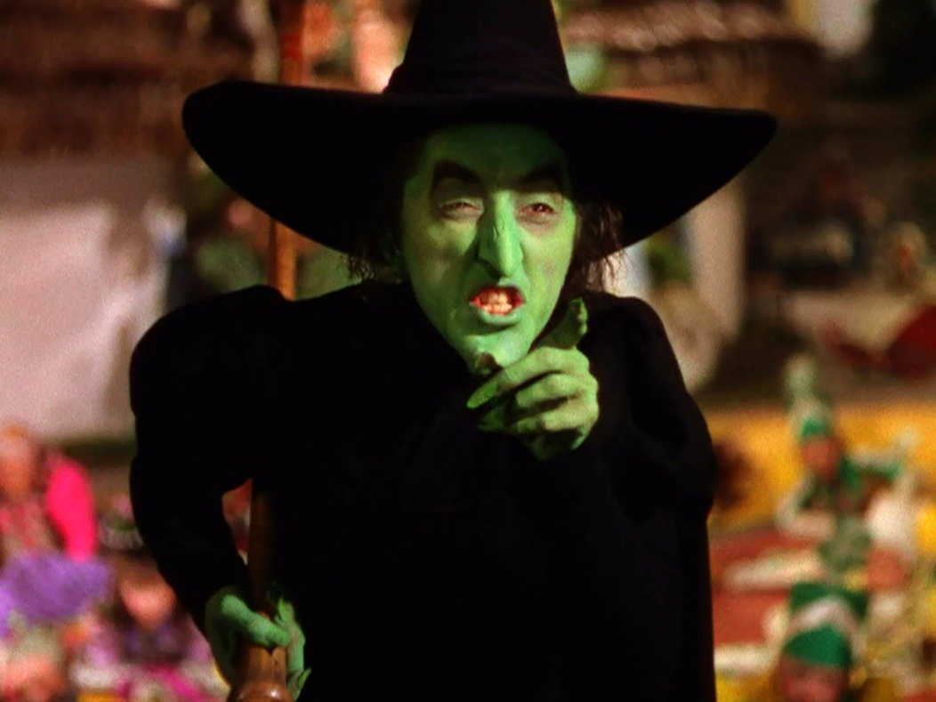
Wednesday Nov 5
Get to Researching my PRETTIES!

Slide 13
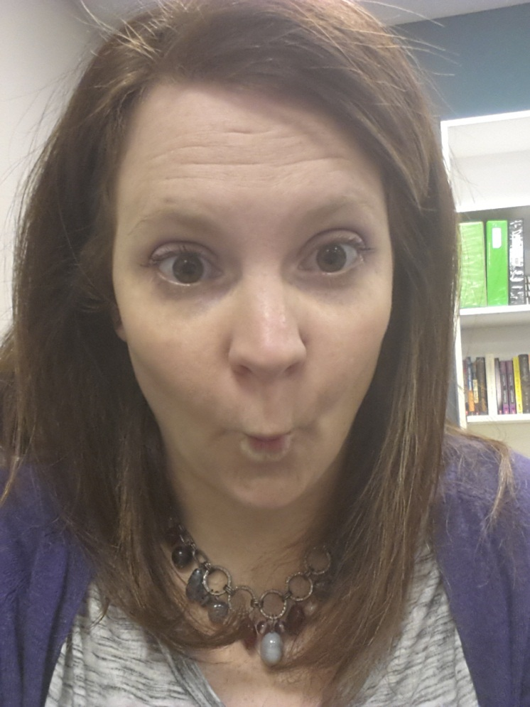
November 6
OOOOHHHHH NOOOOOOOO! I went in to research folders this morning and some of you had nothing! You missed out on points! Don’t miss the opportunity today, GIT-R-DONE.
SSR
Journal- Fix the sentence:
Do to the horrible whether the football game was cancelled and re scheduled for next wednesday

Slide 14
1A- Are humans valid test subjects?
Direct Quote =
Fehlings calls it an "unrealistic hurdle" to expect researchers to validate all their findings in bigger animals, like pigs and monkeys, before launching a clinical trial. "If every treatment bad to be replicated in monkeys, we would never move forward," he says. But Miller points out that a lab rat isn't the ideal stand-in for a person with an injured spinal cord. "The size of a lesion in a rat is very different, and their spinal cord is somewhat different," she says. "Even if you injure them badly, they can get some hind leg locomotion back, which is not the case forhumans. You can't predict what would happen in humans on the basis of a rat.“
Paraphrase (summary in my own words)
Unfortunately, there are laws against people who are willing participants in potentially unethical studies preventing them from being tested on. Even a willing participant can not be tested without the consent of the government and testing bureaus.
Lunau, Kate. "Taking a chance on a miracle: as desperation leads patients to experimental treatments overseas, a leading neurosurgeon says it's time for human trials on stem cell therapy here." Maclean's 21 Nov. 2011: 64+. General OneFile. Web. 6 Nov. 2014.

Slide 15
Journal – If you had a minion horde for a day, what would you do?

Slide 16
You get an extra research day. You should be thankful and feel like this.

