Slide 1
Good Morning!
10/20/14
If you have your A project, please staple that and your B project from the box to your yellow sheet. Return it to the box!

Slide 2
Agenda
SSR
Journal
HO AOTW – I know you are stoked!
Notes about PIE
Activity
Exit Ticket

Slide 3
Journals
Journals will get a grade every 2 weeks for completion.
You will also be required to “publish” one every two weeks ☺
Today the topic is: I couldn’t live without….because….

Slide 4
Notes

Slide 5
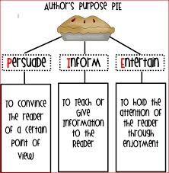
Author’s Purpose

Slide 6
Create an example for each Author’s Purpose ie PIE
P-
I-
E-
Faux Pelini/ State of the University
You should apply to UNL, they have many awesome sports teams and you will have a great time!
The school colors of UNL are crimson and cream.

Slide 7
Create a PIE chart as a group on the large sheet of paper at the front of the room.
Include PIE labels and what makes each PIE.
This is persuasive because…

Slide 8
Finish Large PIE sheet
Figure out who is speaking for your group.
Figure out what they are saying.

Slide 9
Exit Ticket
Tell me about PIE.
Due Dates:
A LEVEL and yellow sheet DUE TODAY!
NRI assigned 10/22 DUE 10/26
AOTW DUE 10/24
Book Talk DUE 10/29

Slide 10
What happens to me when you don’t listen the first time.
October 21, 2014
Pick up an acorn and set your reading goal. When you are done, return it to my desk.
Include your name on your acorn.

Slide 11
Agenda
SSR
Reading Goal
Journal
Notes
HO Real World Writing Prompts
Activity
Exit Ticket

Slide 12
Journal
Fix the sentence below:
albert Einstein once says "the true sign of intelligence is not knowledge but imagination."
Then tell me what you would do if you were as famous as Einstein.

Slide 13
Notes

Slide 14
Creating Writing with the End in Mind
What do you want your reader to know?
Your end result determines your starting point!
Yes you need to write this.

Slide 15
Real World Writing Prompts
Read the handout.
What do you notice?

Slide 16
1 Topic = 18 Topics
Purpose | Possible Writing Topics
Express and Reflect Feel/Lessons
Inform and Explain What does the reader not know?
Evaluate and Judge “worth”, good/bad
Inquire and Explore Wrestle with a question?
Analyze and Interpret “why”
Take a Stand/Propose a Solution
One Topic

Slide 17
Exit Ticket
Write one persuasive sentence and one informative sentence.
Due Dates
Real World Writing Due Tomorrow
AOTW DUE 10/24
NRI assigned 10/22 DUE 10/26
Book Talk DUE 10/29
BRING MONEY FOR BOOK FAIR

Slide 18
Journal
Social media includes any web based social networking in which people can interact and communicate. How familiar are you with social media? Do you think it is having a positive or negative effect on society? Explain your answer.

Slide 19
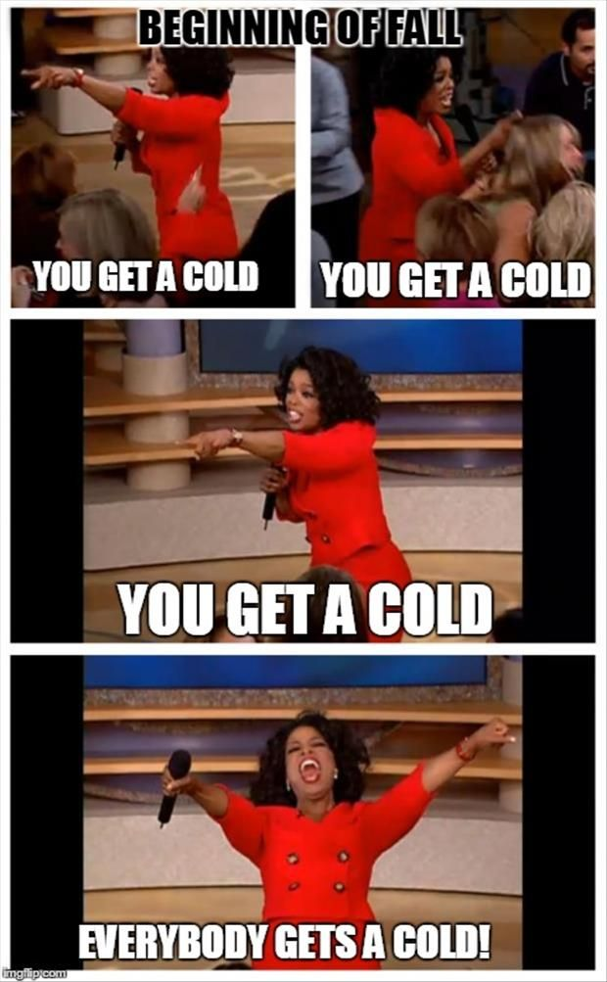
October 22

Slide 20
Do you have this?
My family for the war
Can you let me know? It’s overdue and they want it back!

Slide 21
Agenda
Journal
Book Fair!
SSR
HO Research Paper
Activity
Exit Ticket

Slide 22
What is a research paper?
Facts
Boring- no climax just fact stating
MLA format
Sources cited- where info came from
Quotes
Information
Topic sentences for each paragraph
Organized
Chronological- dates time
Statistics
No personal pronouns = write in 3rd person
Thorough explanations
Straight to the point
Intro and conclusion tie together
Thesis
Detailed
Quotes/ are cited
Timeline/chronological
Long
Intelligent language choices
No opinions
Only 1 topic
Citations/parentheticals
Follows thesis
3rd person
Concluding sentence
Topic sentences
Informative/ only facts
Compound/complex sentences
No personality

Slide 23
Exit Ticket
What did you learn from the example research paper?
Reminders
Real World Writing Due Today
Research Scavenger Due Tomorrow
AOTW DUE 10/24
NRI assigned 10/22 DUE 10/26
Book Talk DUE 10/29
FOLDER

